Slide 1
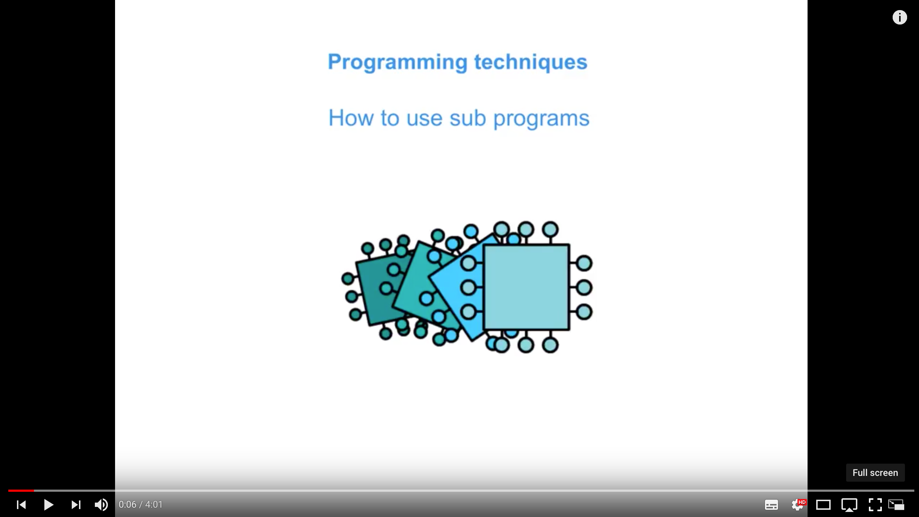
Programming Functions and Procedures
Lesson 1
A Rolling Dice Game

Slide 2
Expectations
COMPLETING HOMEWORK WILL PREPARE YOU FOR CLASS

Slide 3
Watch and take notes
How to use sub programs
Notes:
https://www.youtube.com/watch?v=9gyO0ZOXQU4&list=PLCiOXwirraUDRk5TlB2ulS3V2-0tB3vcS&index=6

Slide 4
Spot the typos
Do this now
15 seconds per slide
Note the error in your exercise books

Slide 5
All students will know
Learning Objectives
How to declare and use constants and variables
The main data types: integer, real, Boolean, character and string
Notes:
Define IDE

Slide 6
All students will understand
Learning Objectives
Understand and use data types: integer, real, Boolean, character and string
How Python handles different data types.
What a syntax error is and how to embrace error messages

Slide 7
Some students will understand
Learning Objectives
casting variables between data types
Variable scope: local and global scope

Slide 8
Example Code
Notes:
Can anyone tell me what this code does?

Slide 9
Example Code
Headline Text
What types of variables are shown here:
numberOfStudents = numberOfStudents + 1
circleArea = 3.142 * radius * radius
while found == False …
answer = “Y”
print (studentName)
integer
Real or float
Boolean
char
string

Slide 10
Definitions of data types
Table
Data type | Type of data | Typical amount of Memory
integer
A whole number: 1, 0, -2
2 bytes
Real or float
A number with a decimal point: 1.5, 0.0, -68.4
4 bytes
A single ASCII character: A, b, 3, ! Or [space]
1 byte
char
Boolean
True or False; 1 or zero
1 bit; but commonly 1 byte
string
Zero or more characters
1 byte per character in string
Notes:
Guess

Slide 11
Summary
Python’s Development Environment
As well as variable, you can define constants in a program
PI = 3.14157926535
MONTHLYTARIFF = 15.60
Constants are typically shown in uppercase
Why declare a constant instead of a variable?
Can a constant ever change its value?
Notes:
Quickly demonstrate INTERACTIVE and SCRIPT mode.

Slide 12
Tasks
Programming Challenge
Simulate rolling two dice and print the values with the highest first.
And output what dice roll won.
Location: On the Year 9 shared drive:
Notes:
Highlight

Slide 13
Tasks
Independent Activities
You have three C++ Programs to open from within devcpp:
[1] A single sequence
[2] A proposed set of ‘stub functions’
[3] The same program as [1] but decomposed into functions and procedures.
Location: On the Year 9 shared drive:
Notes:
Highlight

Slide 14
Tasks
Independent Activities
Approaches:
[a] Read the program. Predict the outcome.
[b] Run the program. Were you correct?
[c] On paper ‘decompose’ the program into functions and procedures.
Location: On StudentShare:
Notes:
Highlight

Slide 15
Tasks
Independent Activities
Approaches:
[d] Attempt your own solution in C++.
Q: Is your solution similar to mine?
[e] Can you trace the program flow between functions in the third program?
Location: On StudentShare:
Notes:
Highlight

Slide 16
Plenary
Plenary
We have seen how to:
use data types: integer, real, Boolean, character and strings
declare and use constants and variables
use input, output and assignment statements
use arithmetic operators including MOD and DIV
use string methods and conversion functions
Notes:
How was that? Any questions? How do you feel?

Slide 17
Homework
XXX
Complete task XXX o.
Use the Powerpoint slides (48-64) for info.
Location: On Google Classroom
Notes:
How was that? Any questions? How do you feel?

